Slide 1
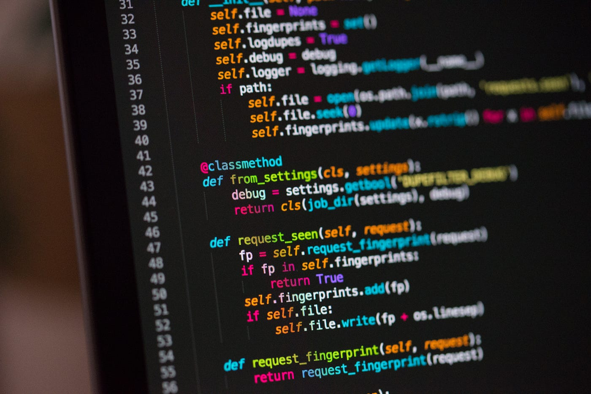
Intro to Python By Chris Hinojosa (IEEE-ESB Vice President)

Slide 2
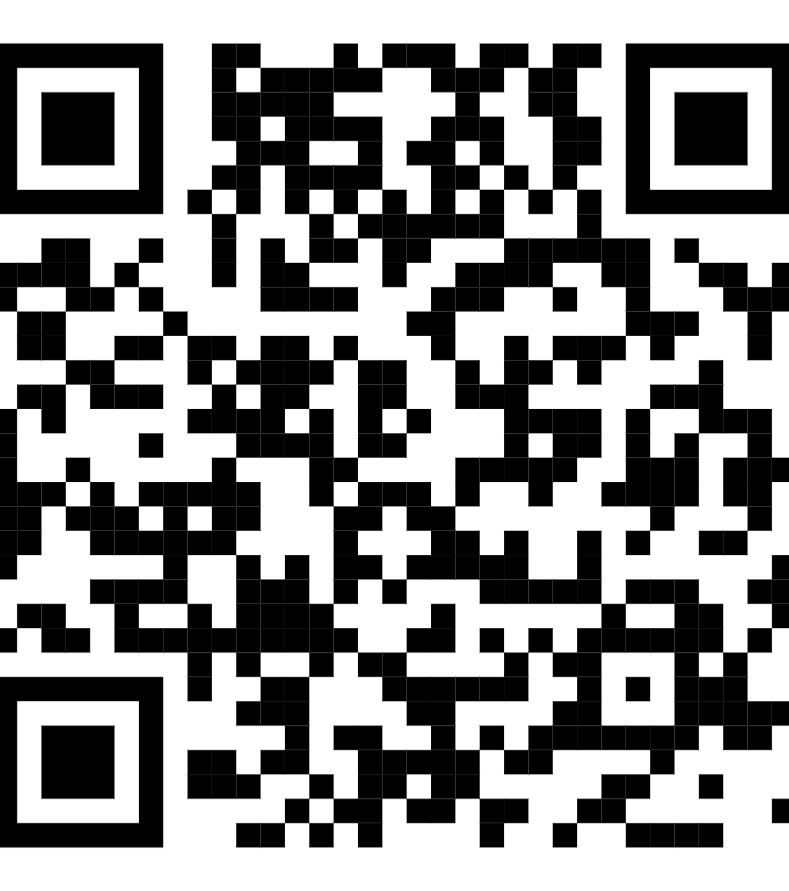
JOIN THE DISCORD
This will have the links needed for this workshop

Slide 3
TABLE OF CONTENTS
TABLE OF CONTENTS
PRODUCT OVERVIEW
1
2
3
4
5
6
7
8
9
Goals
Installation of Python
Installation of VS Code
Basics
Functions
Data Structures
File Operations
String Manipulation
Small Assignment

Slide 4
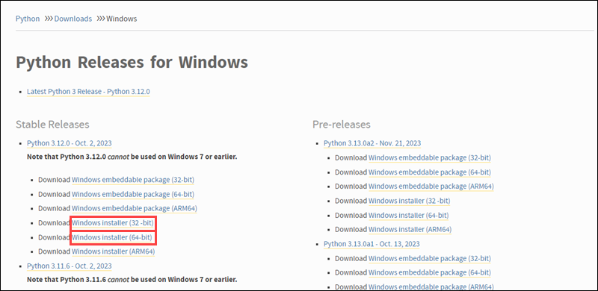
Installing Python
We are going to be installing Python via their website, ask for help if you need it
Run the Installer Executable and make sure that you PRESS, Add Python.exe to PATH and admin priv

Slide 5
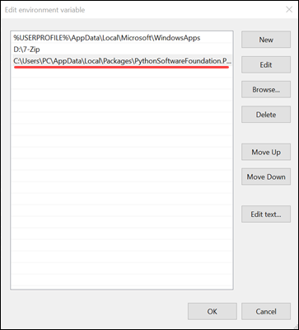

Installing Python
We are going to be checking our path environmental or checking if the path file is good to go, press the windows key and search environmental variables
If this is not FOUND do not worry let me know on the spot please
Run command below within your command prompt to see

Slide 6
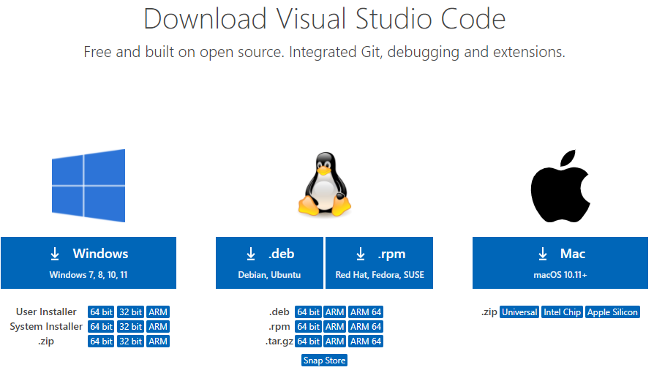
VS Code Installation
Via the link that was given find your installation, if you are windows make sure that you click the 64 bit version for better performance, run through the wizard and you should be good to go
Make sure that extensions

Slide 7
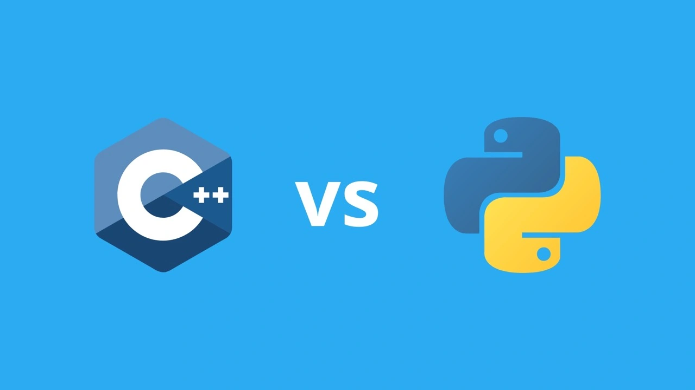
Basic Concepts
What should we be looking out for when we differ from C++???

Slide 8
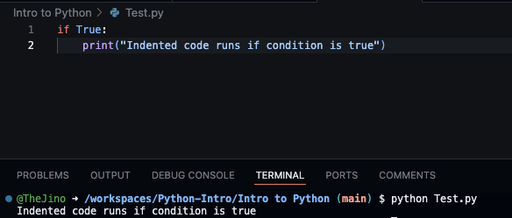
Basics
Let’s make a quick comment in our using an if statement
Notice there is no semicolon or how there is no brackets within the function?

Slide 9
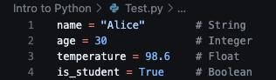
Data Types Variables
As you can see from code, there are no variables meaning that in code, Python reads the data that you input with the variable to determine the data type

Slide 10
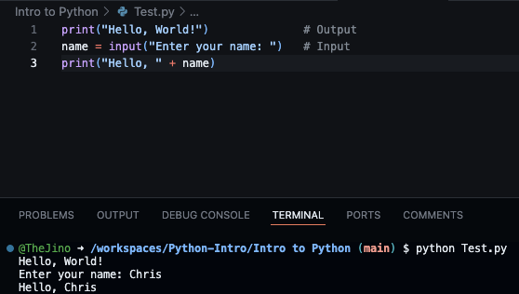
Input and Output
Now remember how you used to cout to print something in the console, now just put print(“text”) :)) and cin is just input

Slide 11
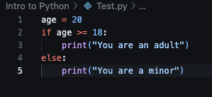
Conditionals
As you can see when you are making an if statement there is no quotation marks rather we are going to be using indentations and colons

Slide 12
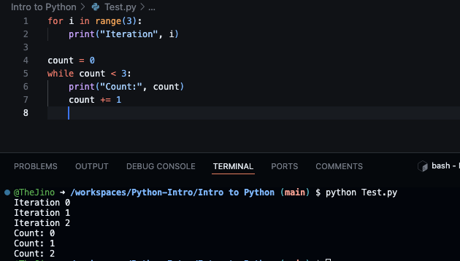
Loops
You are going to see that for looks way different than before you are going to see that you declare a variable within a range
While follows around the same rules as C++ where while the condition is met it keeps going

Slide 13
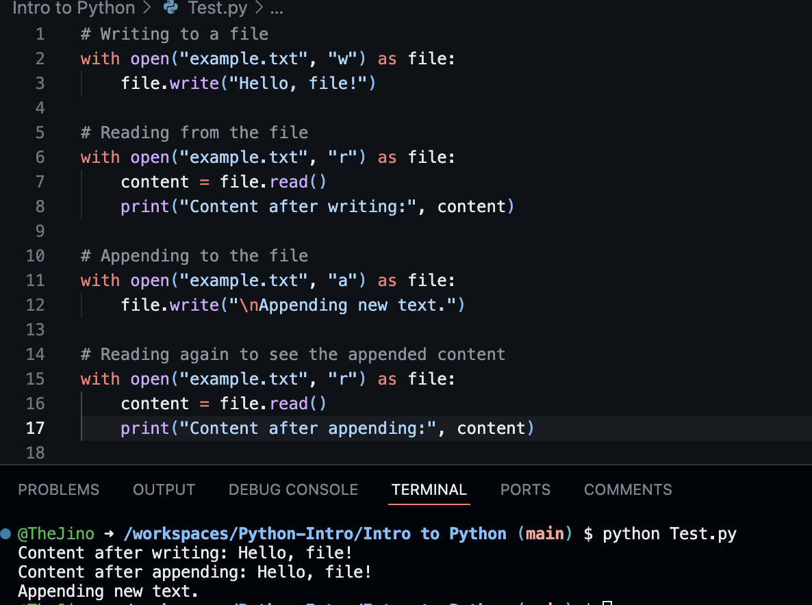
Working with Files
When you are looking at the file structure you are going to notice that you are going to be able to see w, r, and a
W is write mode (notice how it made new file)
R is read mode
A is a append mode

Slide 14
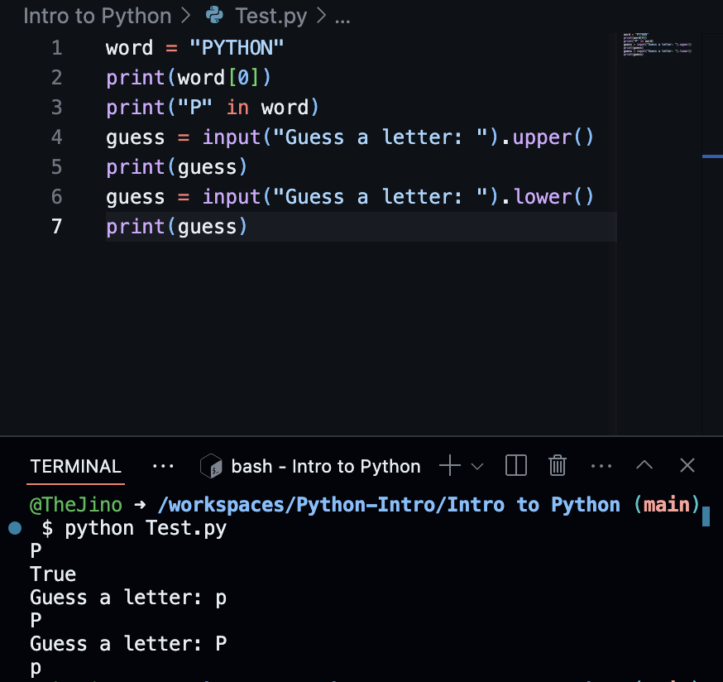
String and List Manipulation
These are some of the basics of the string manipulation, you can see that I declared the word Python and how it can be accessed, awhile guess can be changed to upper or lower case

Slide 15
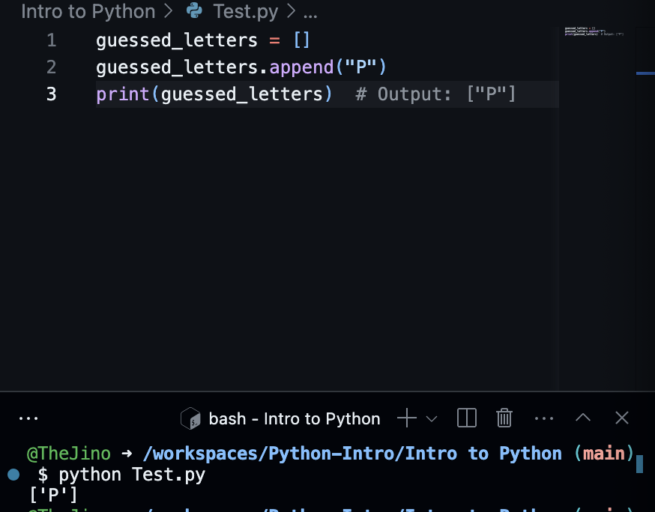
String and List Manipulation
Here are somethings to learn when you are inputting info within a list and this is going to pertain to your assignment you can put data within a string and append it to give it a bit of space

Slide 16
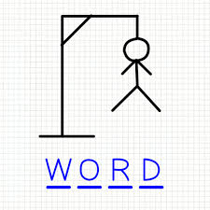
Small Assignment Time
We are going to be working on a small assignment for where you are going to be making a hangman game using Python, if you have an example using C++ on your person you may use if not I will be providing you one

